Slide 1
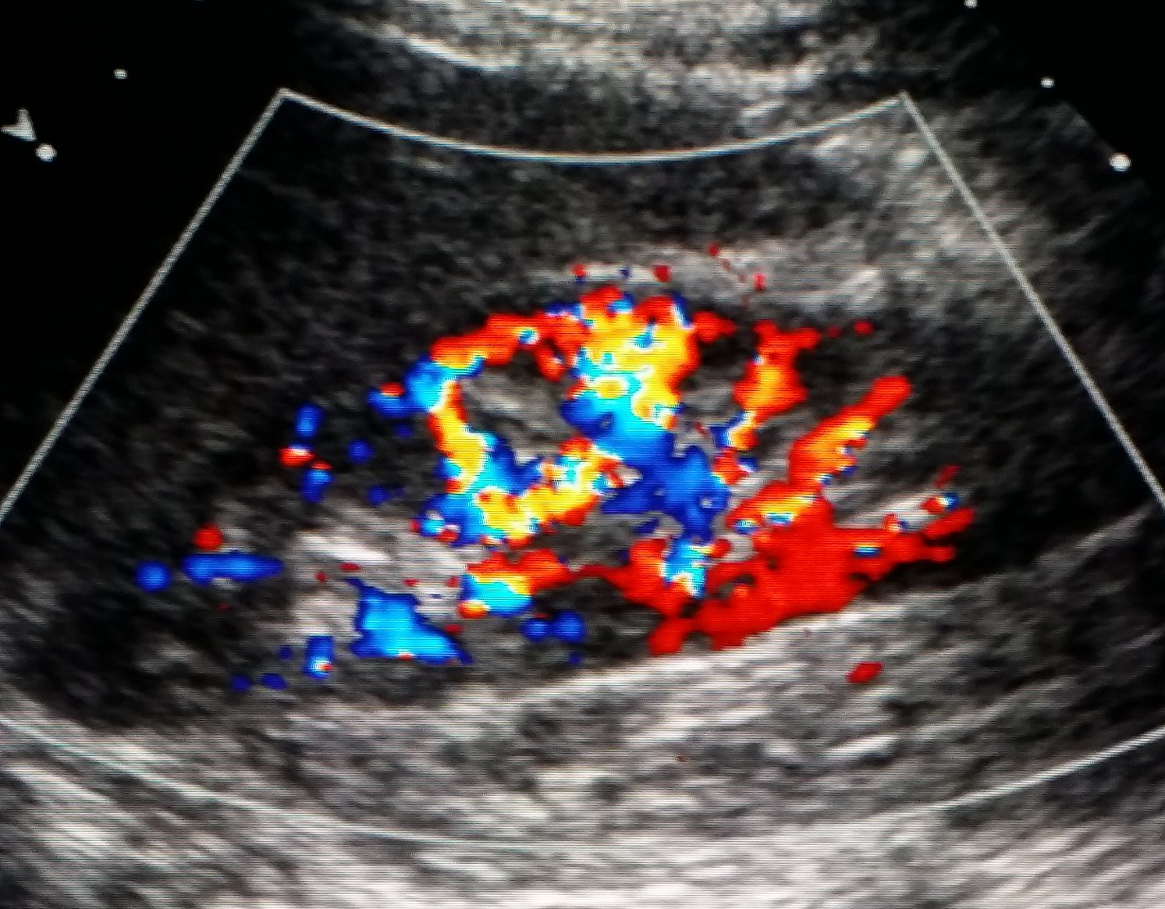
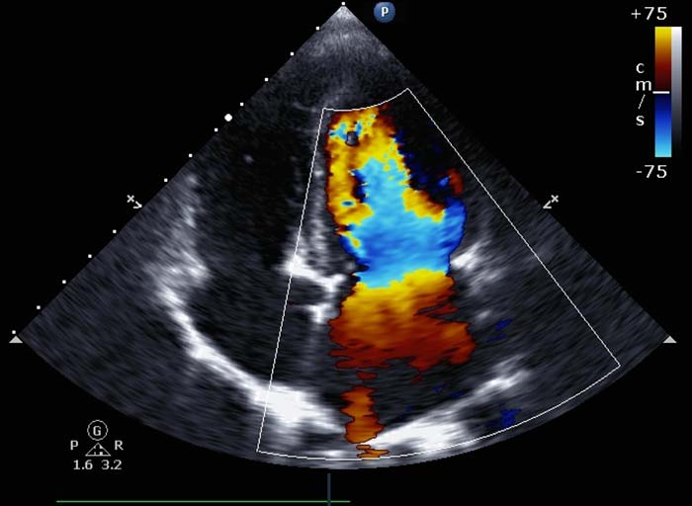
Optimizing Doppler Imaging
Beyond Black and White

Slide 2
Is Color Doppler Angle Corrected ?
No! Color Doppler is steered
Color Doppler uses thousands of sample volumes to analyze millions of blood cells.
All blood cells are moving in random directions at unknown angles.
Throw in some Rayleigh scattering and it is impossible to detect and correct for all angles of blood cell movement.

Slide 3
Color Doppler Steering
Flow
Typically steer 20 degrees left/right of center.
Color displays will change as angle of insonation changes.
Center steer on a 90-degree vessel will show colors from both flow directions.

Slide 4
Angle of Insonation
A color display is totally dependent on the angle of insonation.
Flows acquired at angles close to 0 degrees will have a “brighter” appearance than identical flows acquired at angles closer to 60 degrees.
Do not confuse clinically significant aliased flow with angle created aliasing.

Slide 5
Angle of Insonation
This angle results in a dimmer color
FLOW
This angle results in a brighter color
0 degrees
90 degrees
Flows detected at angles closer to 0 degrees will be brighter than
flows detected closer to 60 degrees.

Slide 6
Color Steering (slant scan)
Controls the position and angle of the color window.
Aids in achieving the optimal angle of insonation for maximum color sensitivity, color rendition and artifact reduction.
Flow

Slide 7
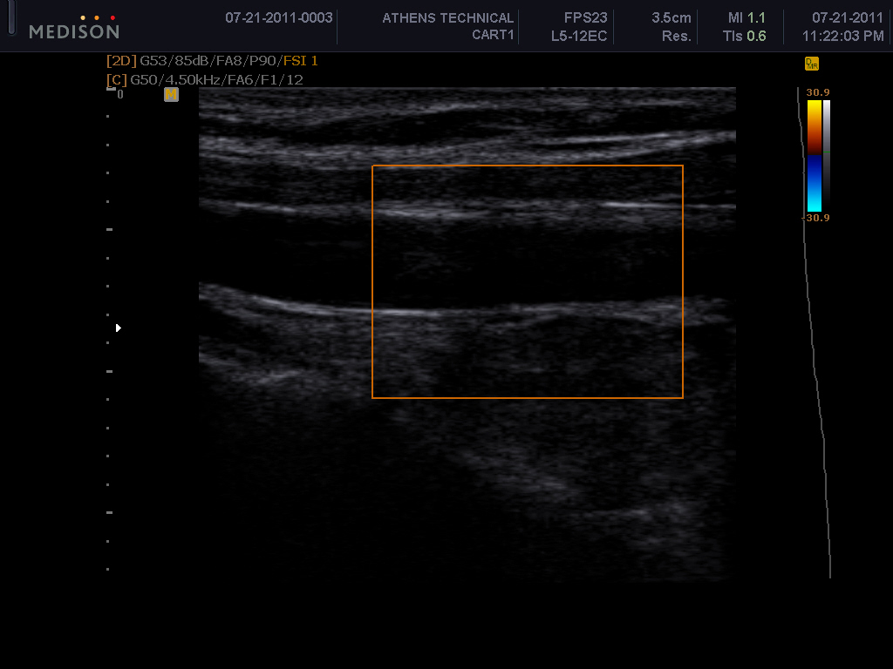
Why is there no color?
Steering, 90 degrees

Slide 8
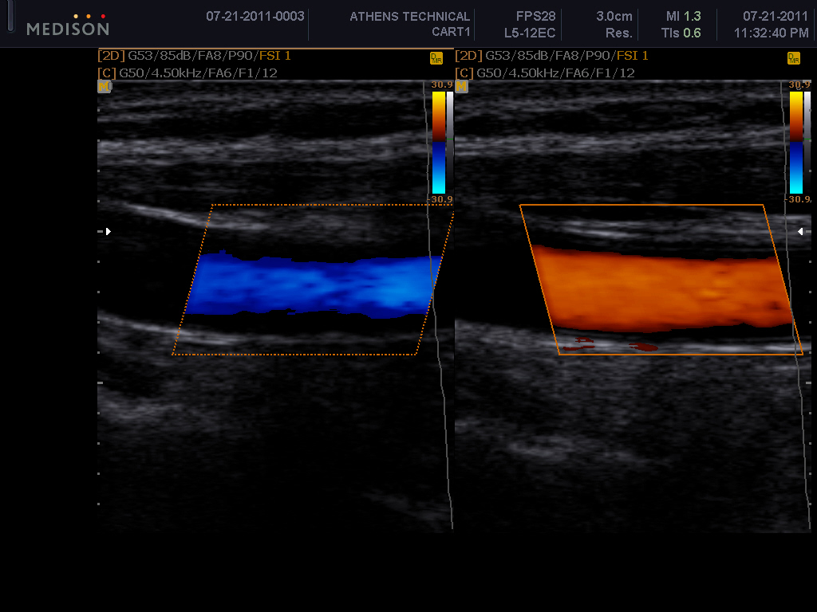
Steering- creates an angle < 90 degrees

Slide 9
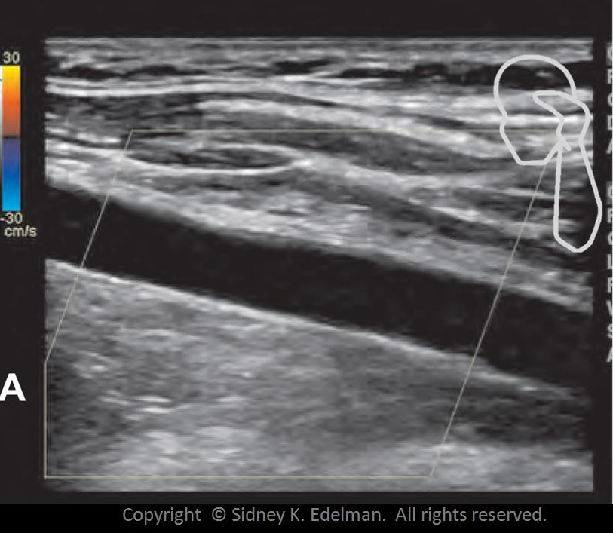
Why is there no color?
Steering effects incident angle. Steering incorrectly created a 90-degree angle

Slide 10
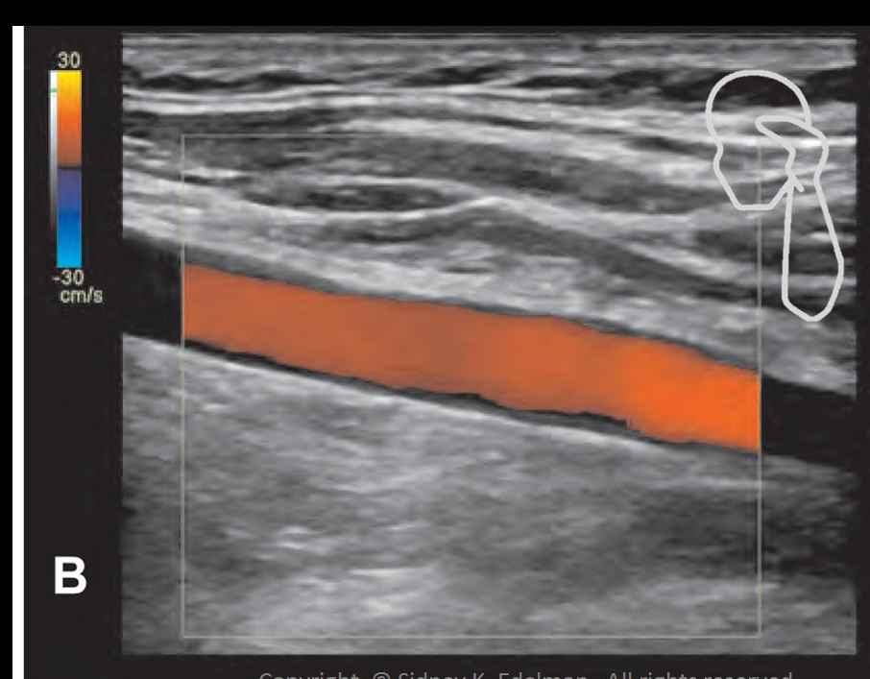

Slide 11
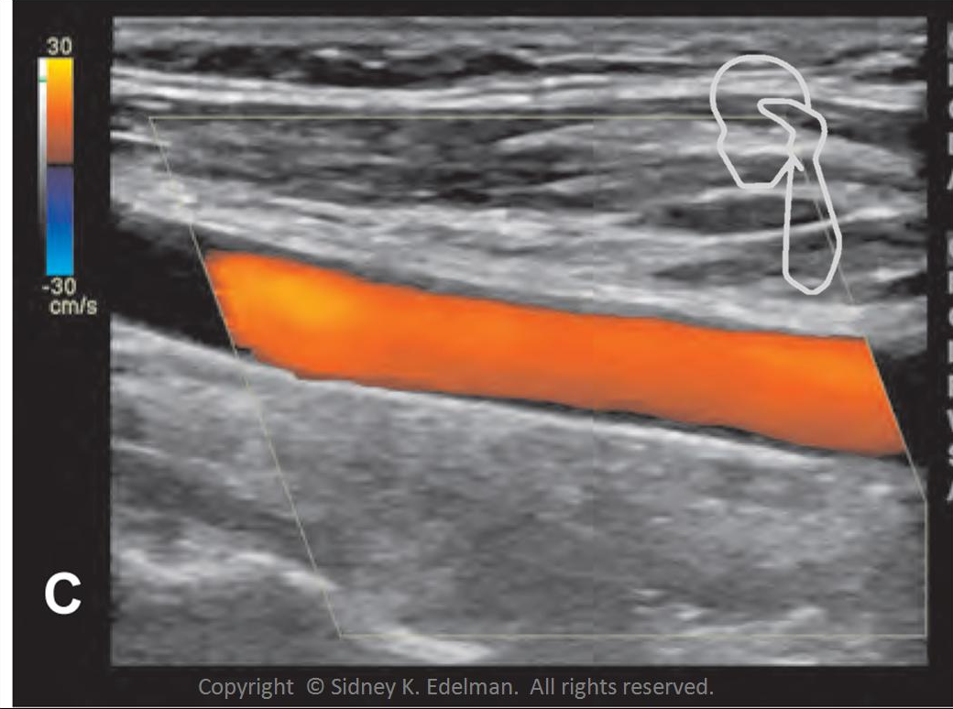

Slide 12
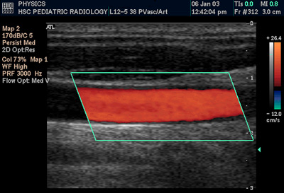
Steering
When we have a rectangular image:
we adjust the size of the box
AND we must steer the box
Steering the box allows us to obtain the optimal Doppler angle on a vessel

Slide 13
How to Steer
Steering is relatively easy once you get used to how it should look. There are several ways you can remember how to steer:
The part of the vessel headed “uphill” should be heading toward the sharp upper corner of the color box.
The most anterior portion of the vessel should match the leading edge of your color box. The leading edge is the portion that won’t intersect your color box if you draw a straight line down.
If your image is transverse on the vessel, you should set your color box to match the image (square or rectangle)
The color box

Slide 14
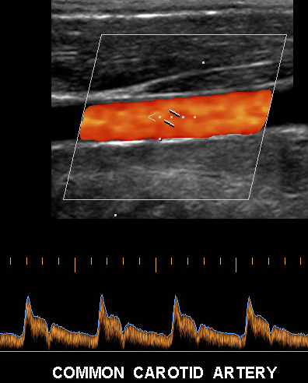

Slide 15
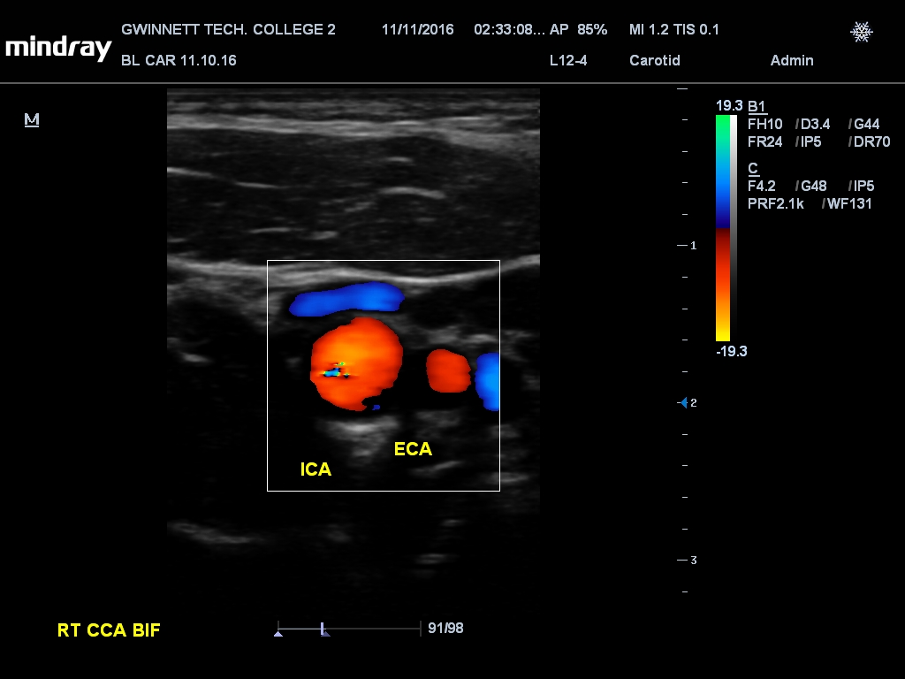
Transverse vessels = straight color box

Slide 16
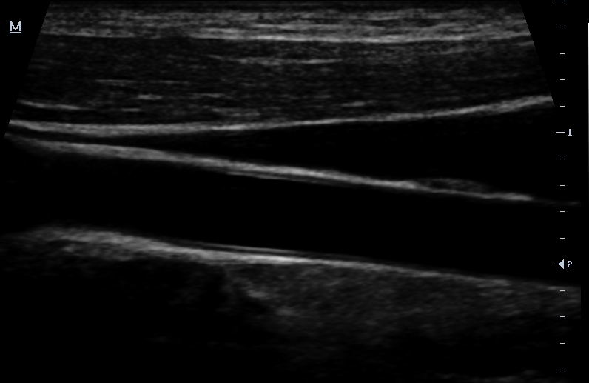
Steering Correctly

Slide 17
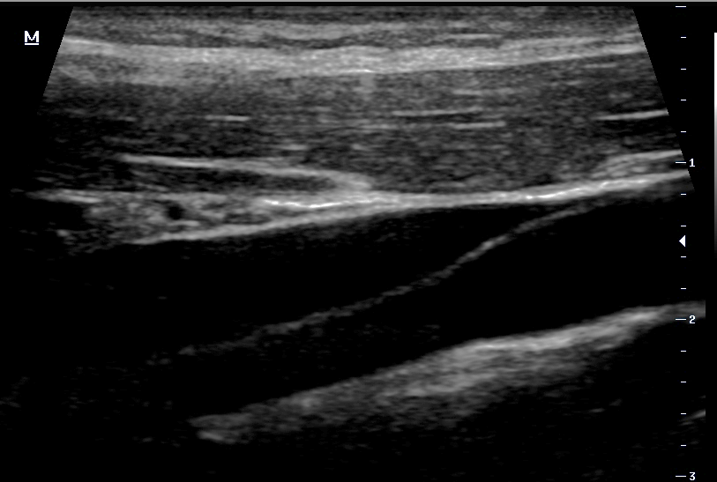
Steering Correctly

Slide 18
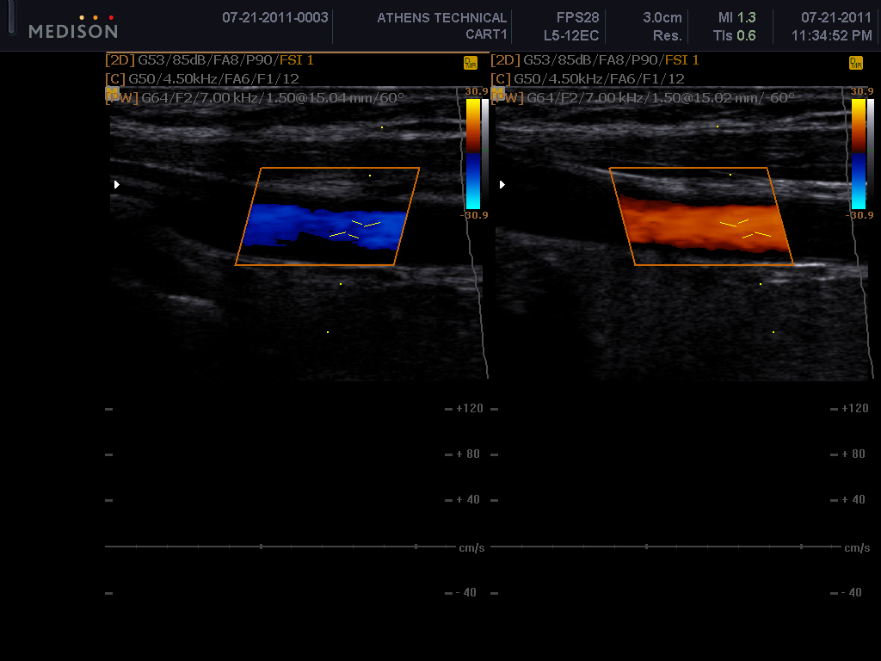
Steering and PW

Slide 19
Color Gain
Amplifies the overall strength of the returning color freq. shifts.
Does not increase insonation power.
Allows control of the amount of color in a vessel.
Always > color gain until color splash occurs then < to appropriate level.

Slide 20
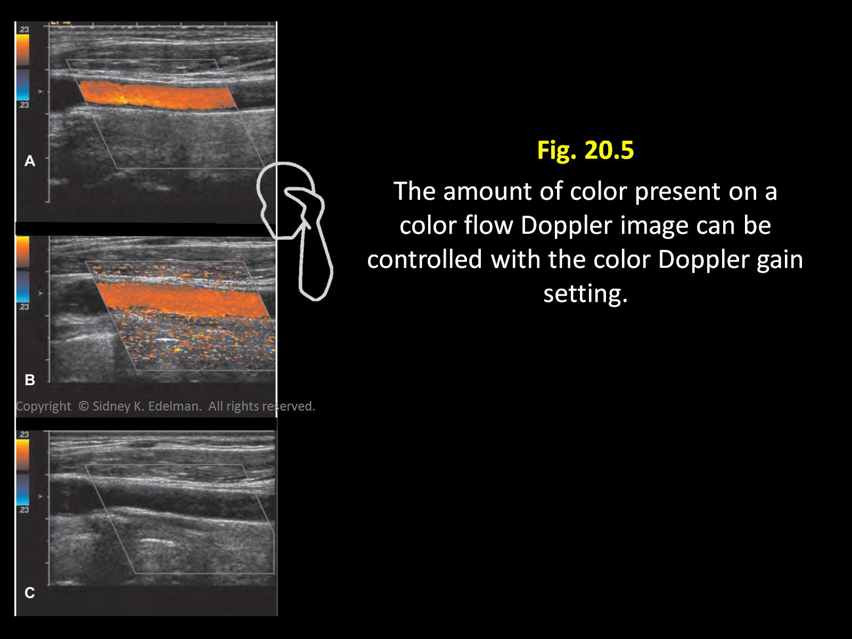

Slide 21
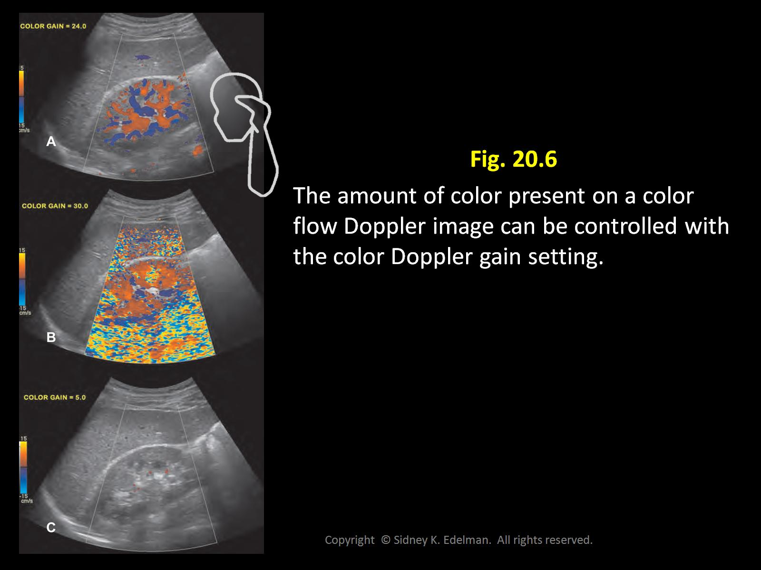

Slide 22
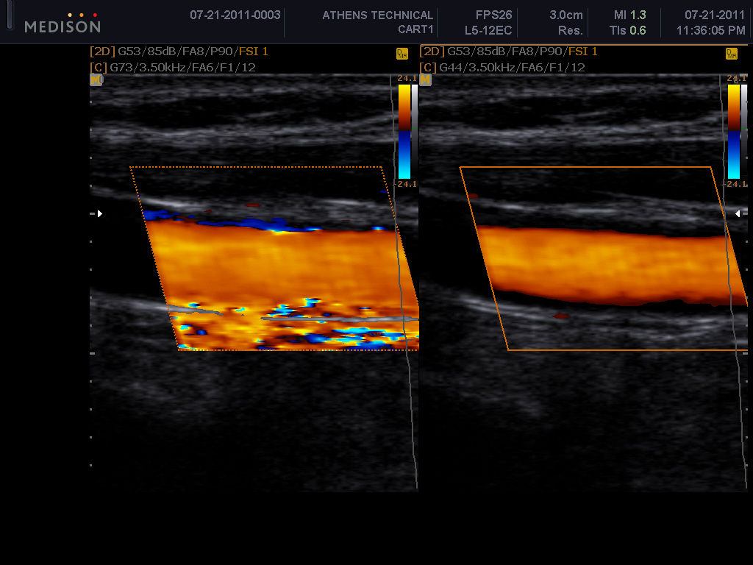
Which control was adjusted?
Color gain decreased

Slide 23
Color Scale (PRF)
Know your anatomy and the normal flow velocity of the vessel
Think of the Color Scale as the speed limit.
High velocity vessels have a higher speed limit so a higher color scale
Larger arteries, main arteries
Lower velocity vessels have a slower speed limit so a lower color scale
Veins, smaller arteries within organs, vertebral arteries
Scale will automatically adjust other controls i.e.. frame rate, acoustic output and wall filters.
Not all ultrasound equipment have the same settings for Color and Doppler

Slide 24
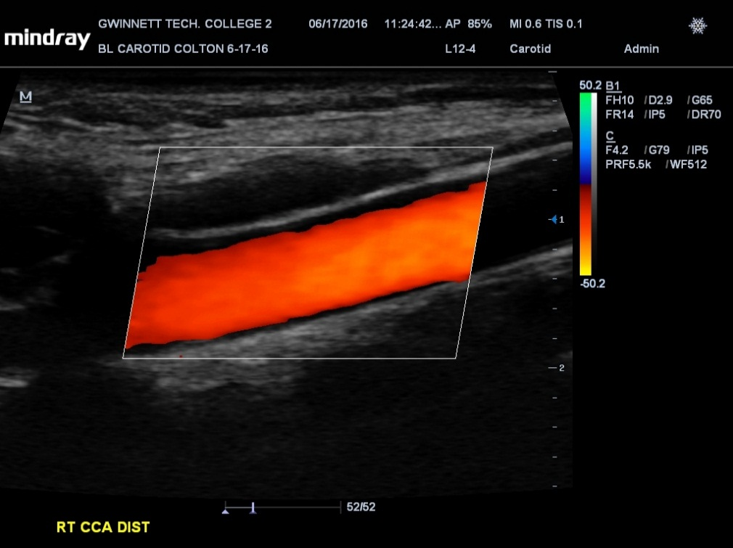
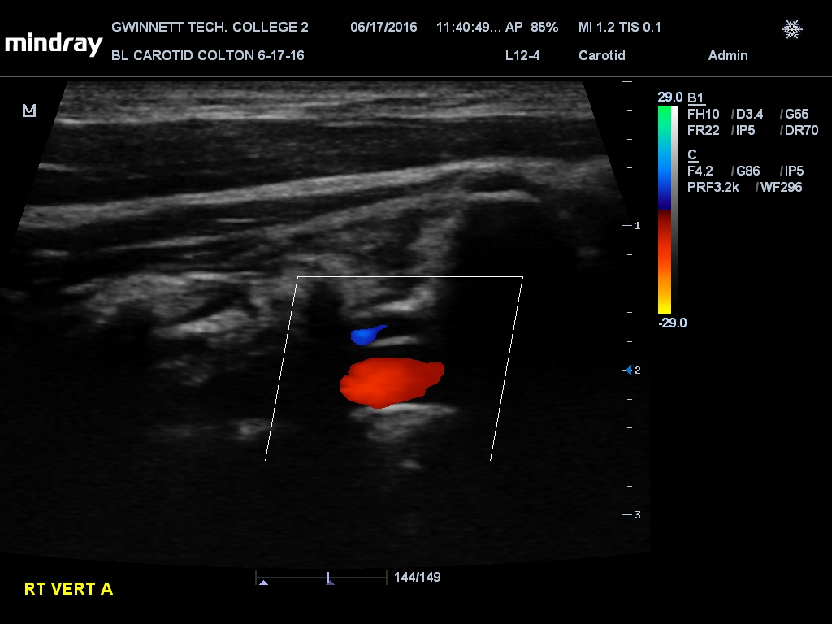
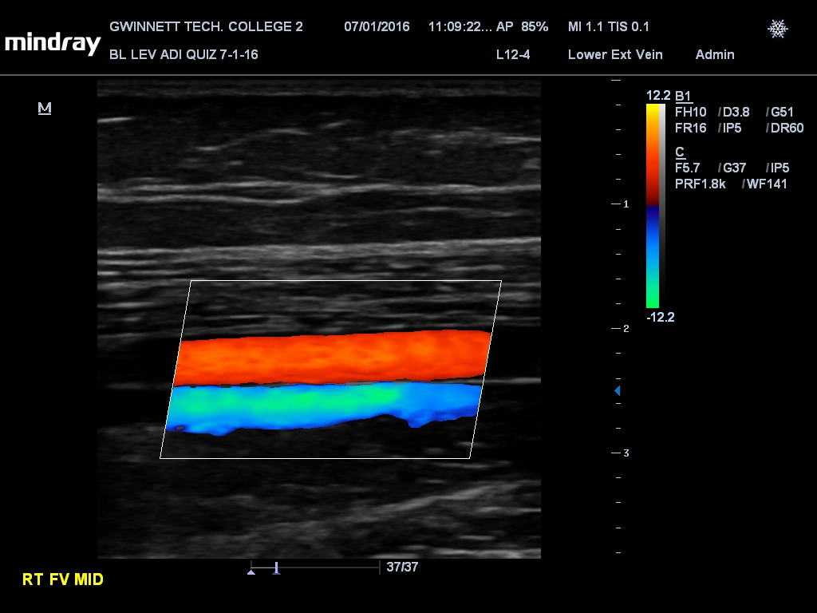
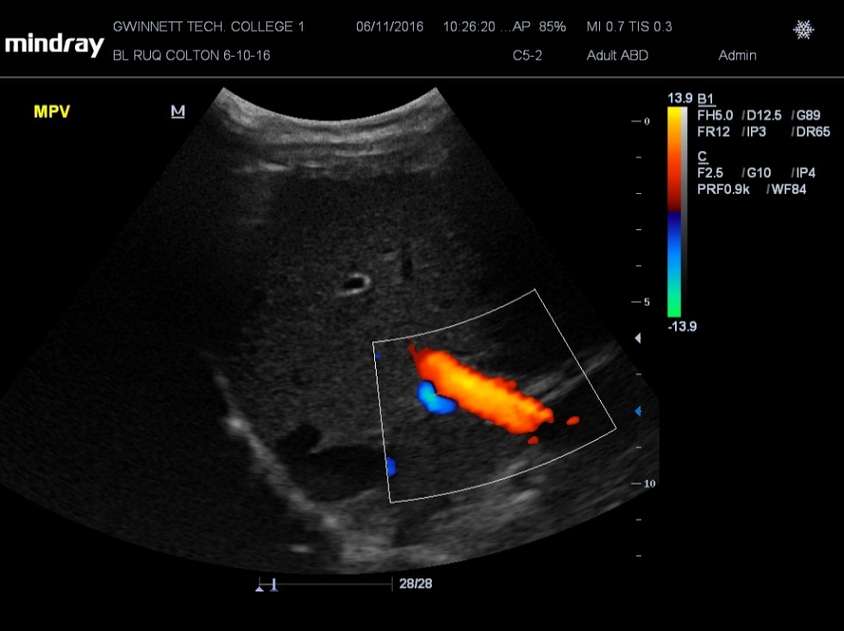

Slide 25
Aliasing
As in spectral Doppler the color signals will “Alias” if the speed of the blood exceeds 1/2 of the PRF/scale.
Red will wrap into blue or just the opposite depending on the direction of flow.
Color uses lower PRF/scale numbers so aliasing is more prevalent than in spectral Doppler.

Slide 26
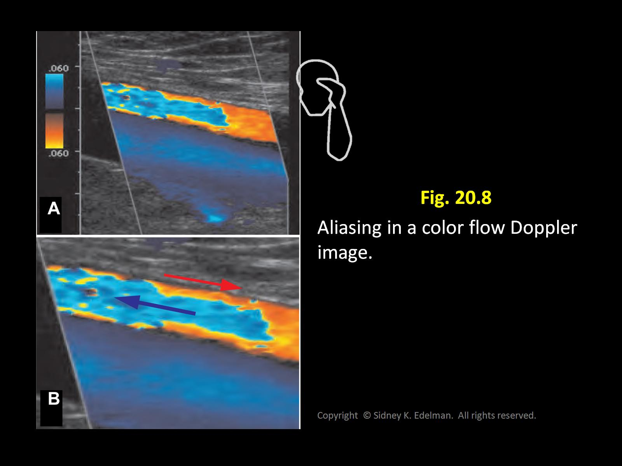

Slide 27
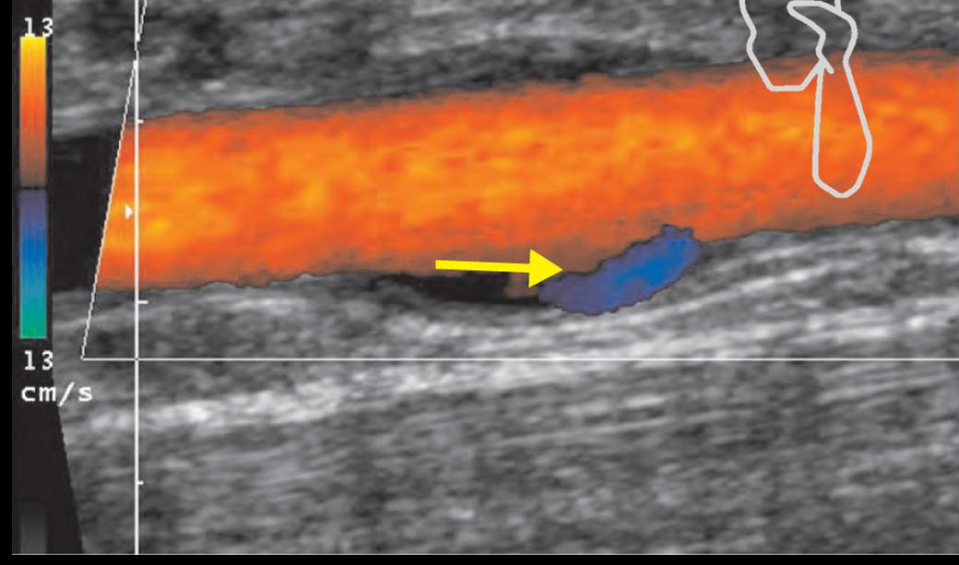
What about flow reversal?
Flow reversal is always easy to determine by the color display.
The primary directional colors displayed in the map you have chosen will always be separated by black,(the baseline color).

Slide 28
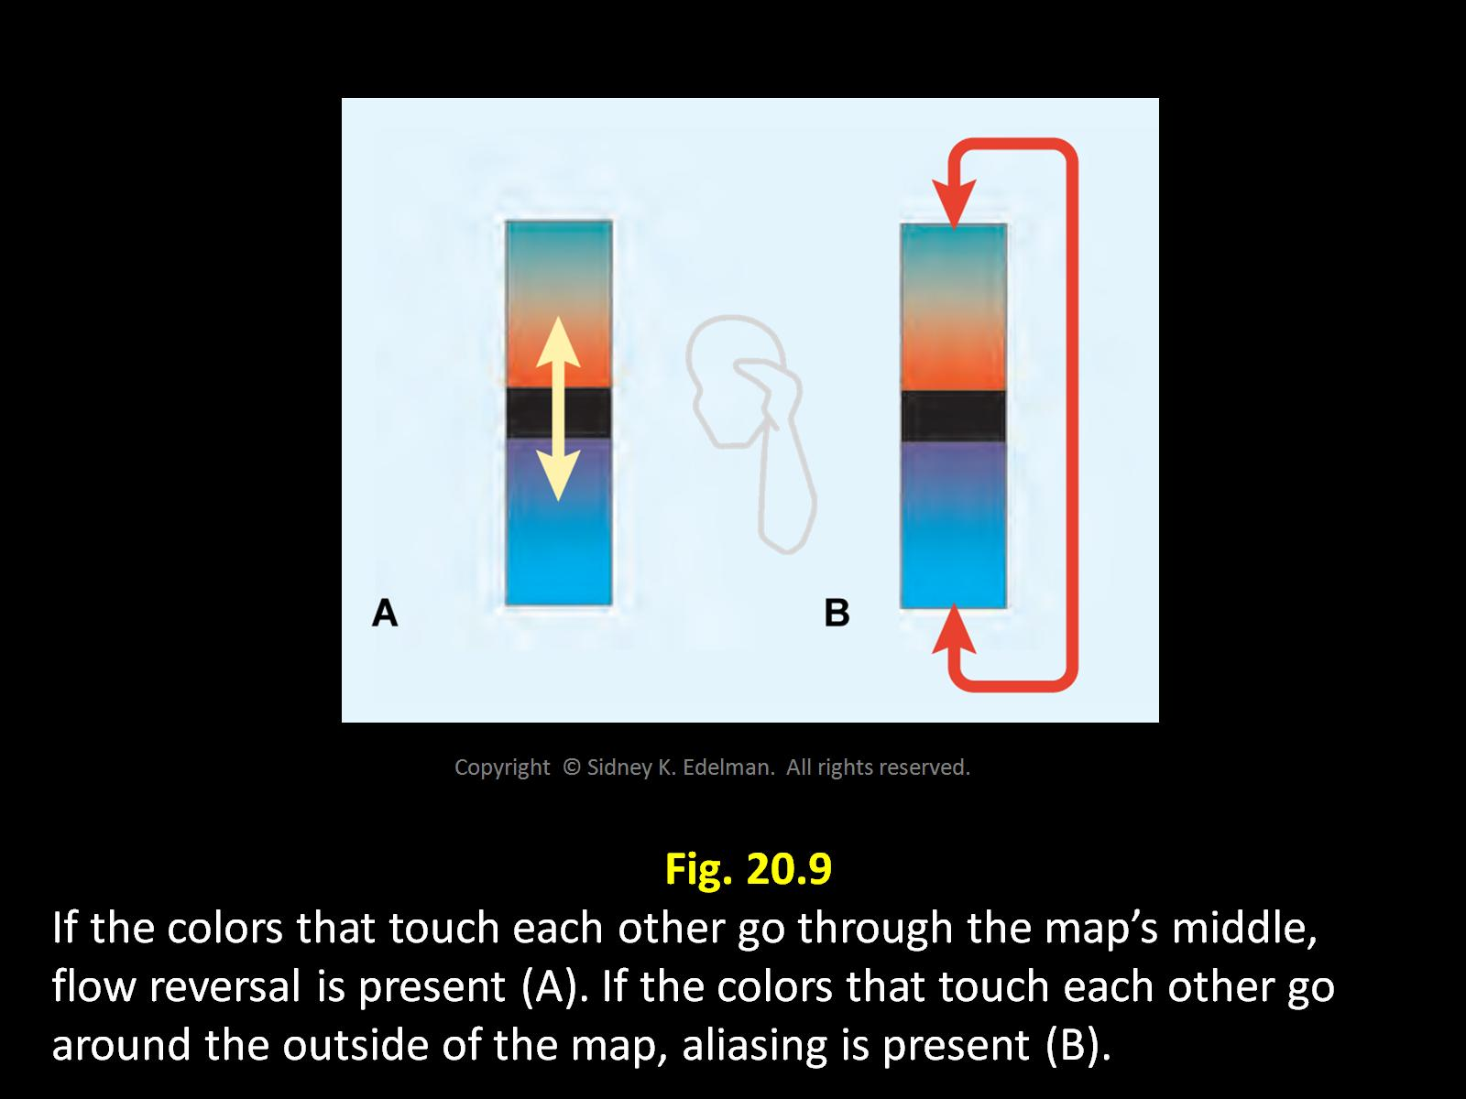

Slide 29
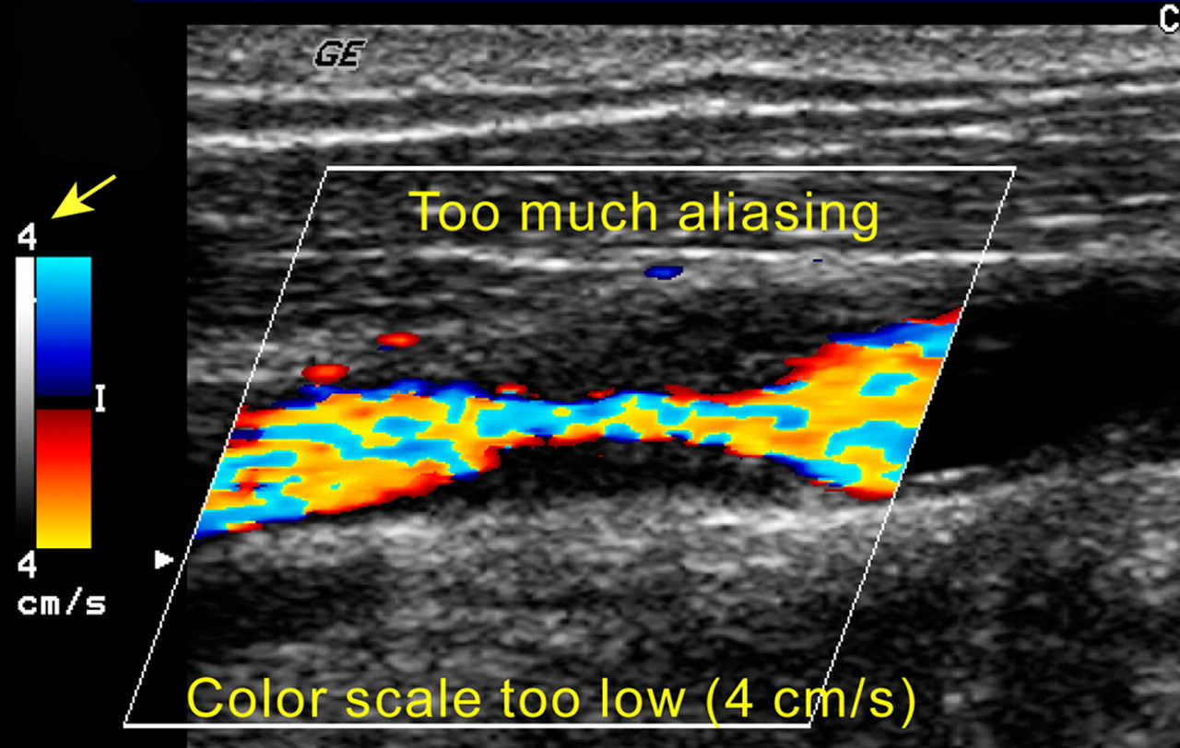
How do you correct color aliasing?
Increase the scale which is increase PRF
Appears as if there is bi-directional flow

Slide 30
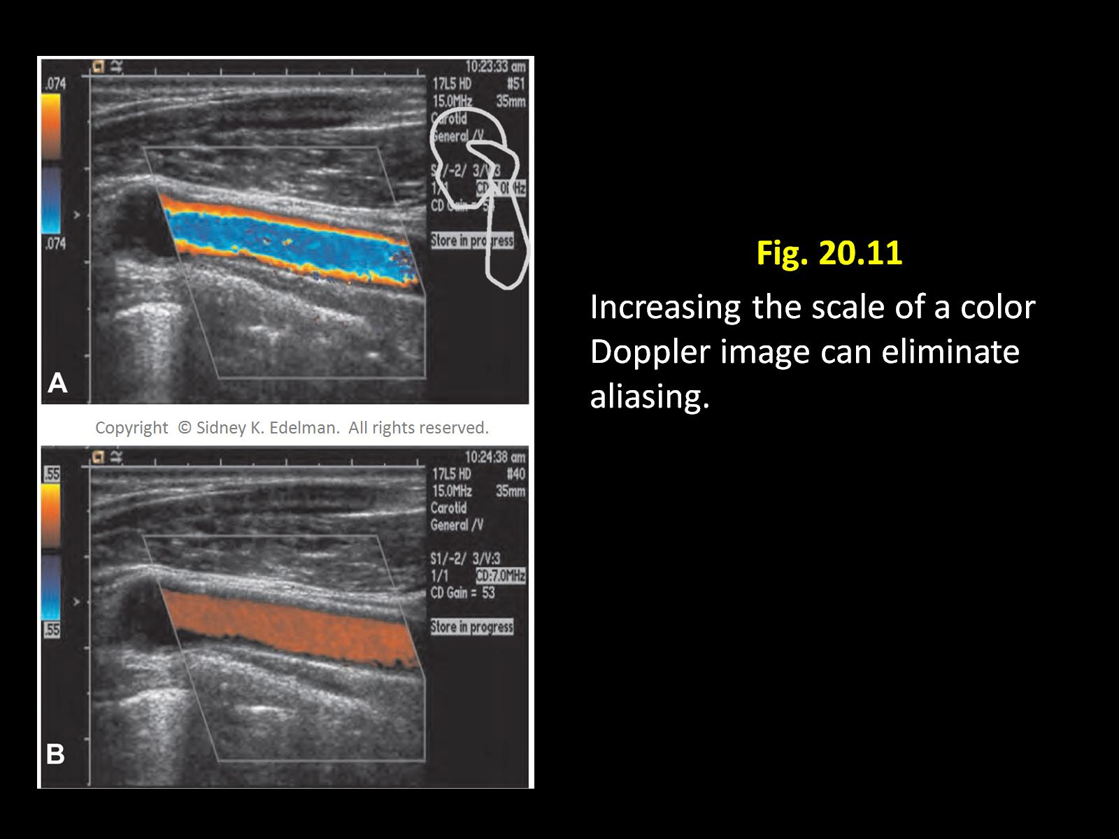

Slide 31
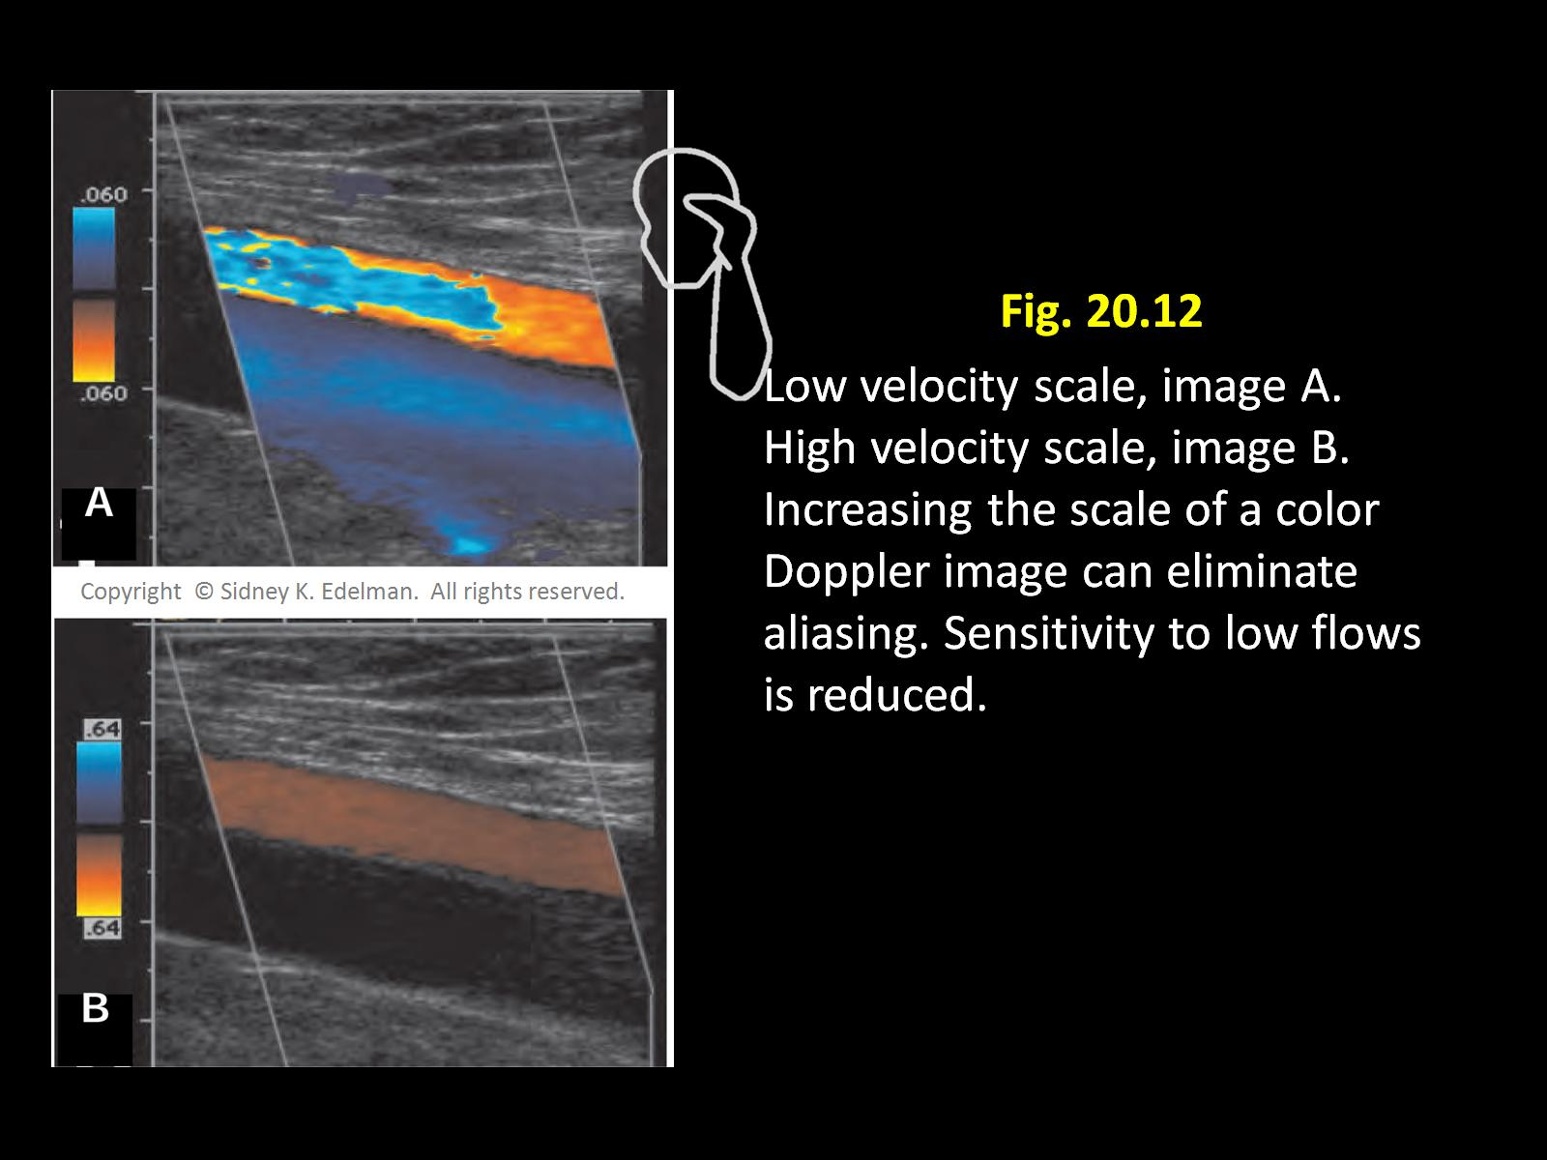

Slide 32
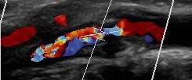
Is Turbulence Displayed the Same Way as Aliasing?
NO !!! A turbulent display will be made up of a mosaic of multi-directional signals (colors).
A turbulent display will separate the primary colors, (red/blue) with the baseline color (black) and a mixture of other colors.
An aliased display will separate the primary colors with other colors depending on the color map but never with black.

Slide 33
What Does Mosaic Pattern Mean ?
A mosaic pattern is simply a mixture of all the available color map colors distributed in random patterns as turbulent freq. shifts would be.
Turbulent blood flow would have blood cells moving in all directions (even reverse) and a mosaic pattern is a display of this activity.

Slide 34
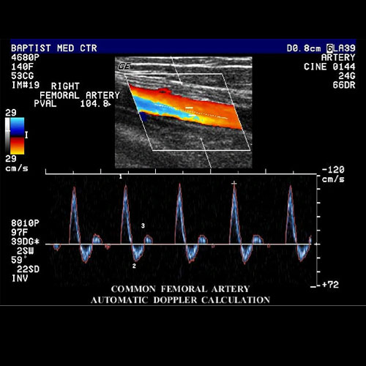
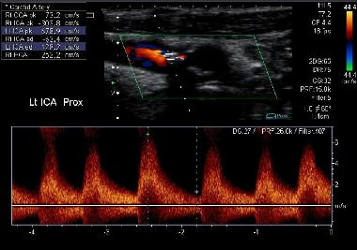
QUIZ QUESTION
Which image represents turbulence?
What is it called when the Doppler spectrum fills in?
A
B

Slide 35
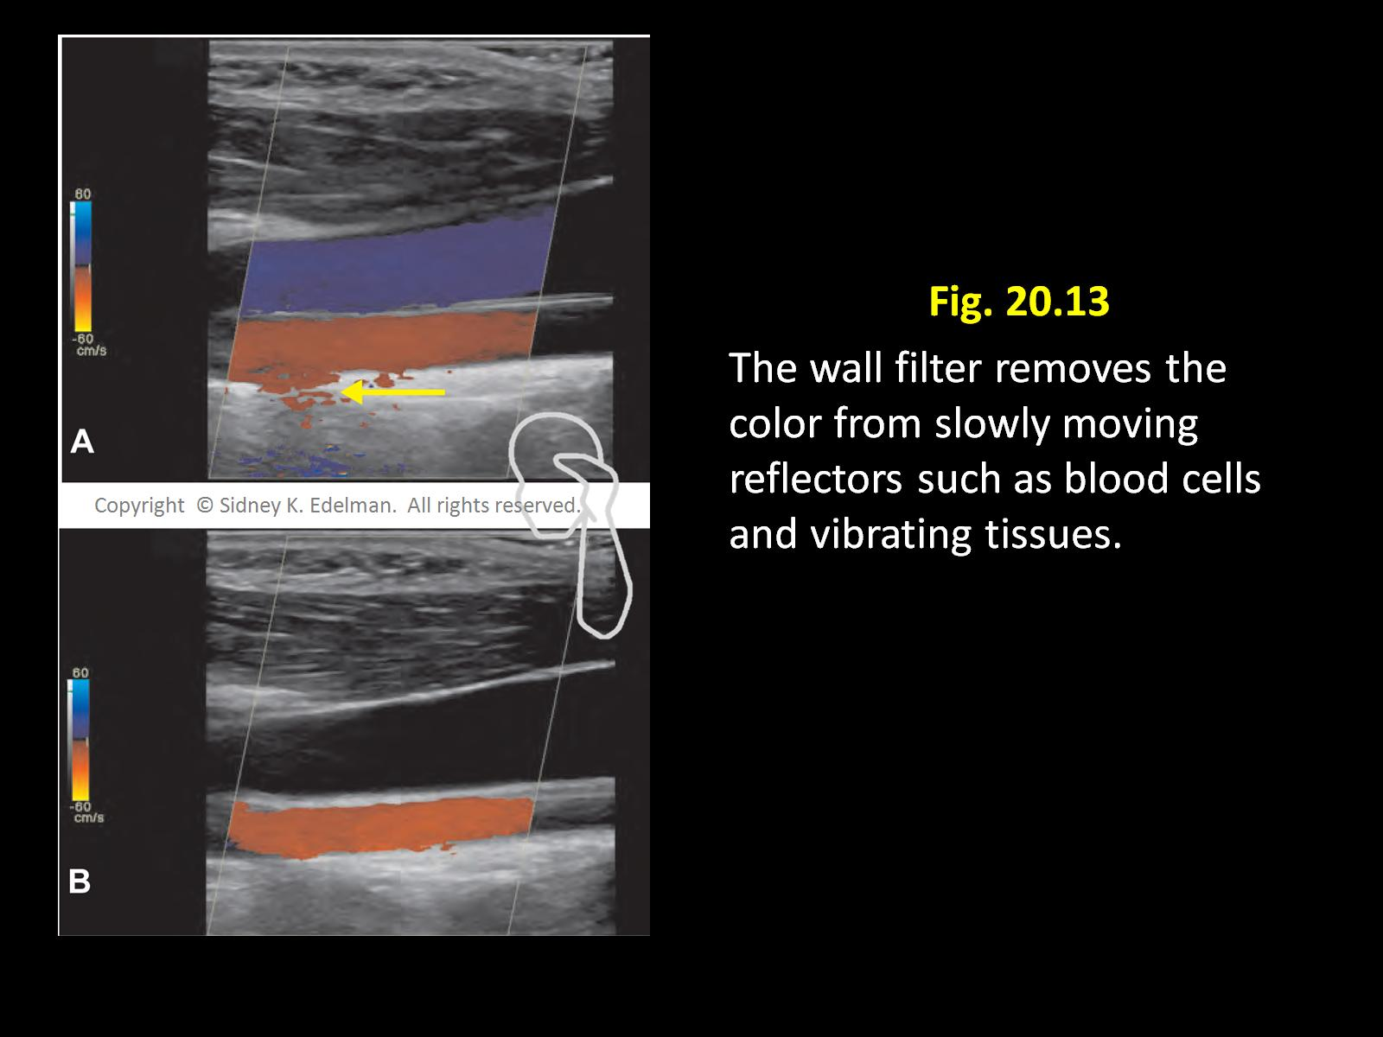
Wall filter

Slide 36
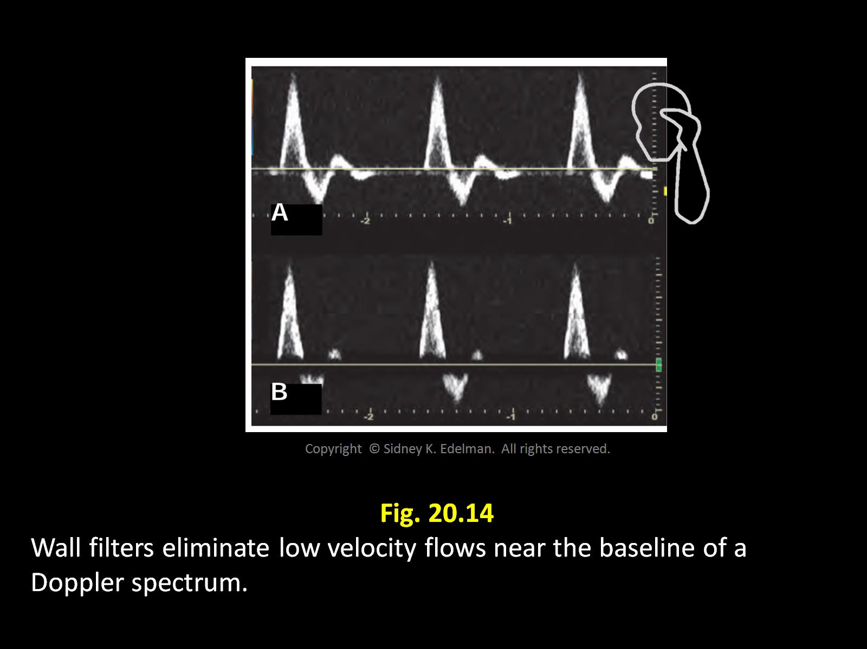

Slide 37
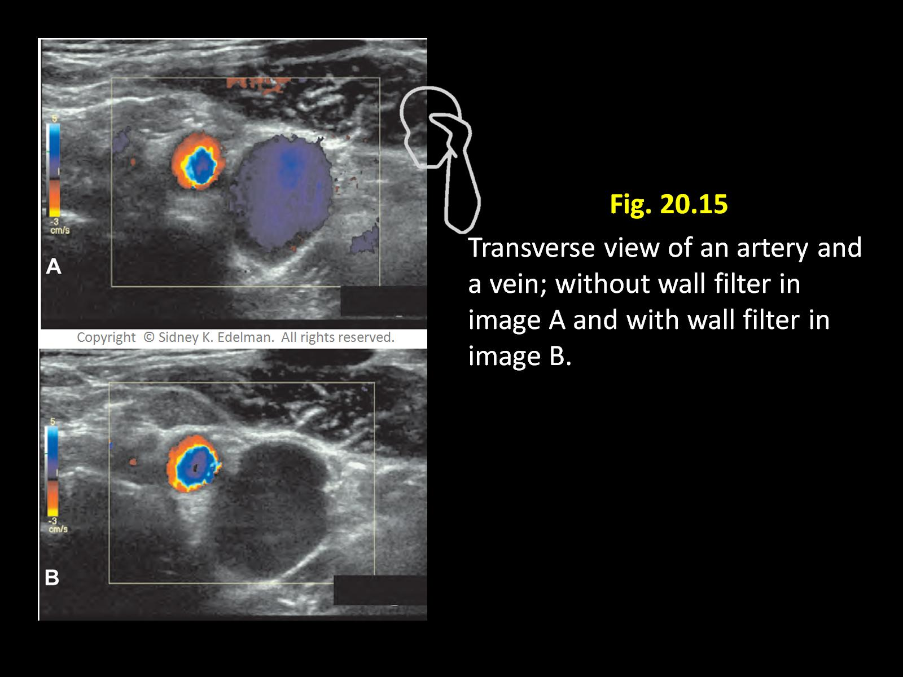

Slide 38
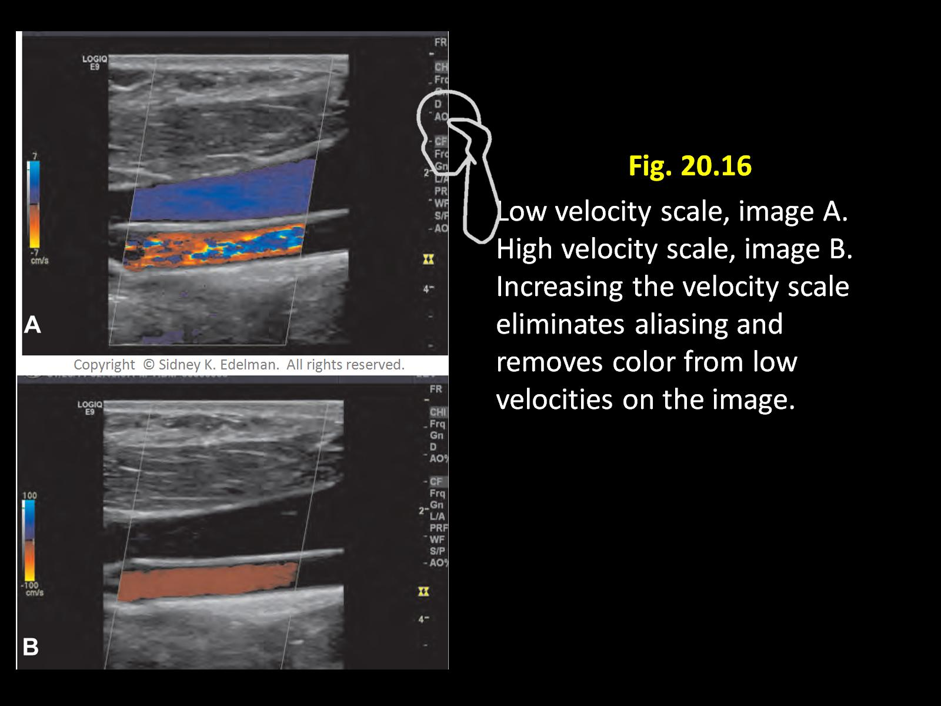

Slide 39
Color Doppler Penetration
CDI penetration can be increased by lowering the Doppler transmit freq..
Lower X-mit freq. > penetration but < signal size so low/slow flow signals may be lost.
Higher X-mit freq. < penetration but > signal size so low/slow flow signals may be gained.

Slide 40
Color gain decreased
Which control was adjusted?

Slide 41
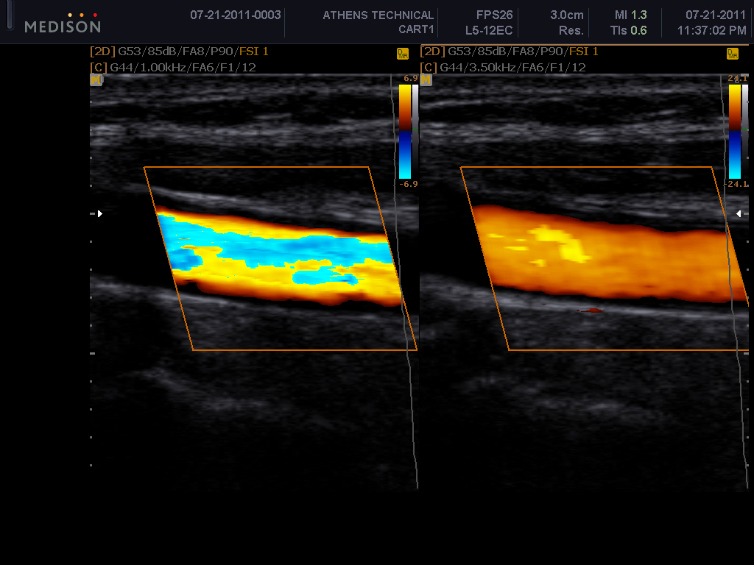
Aliasing
What artifact is demonstrated?
What was adjusted to correct the image?
Scale:PRF

Slide 42
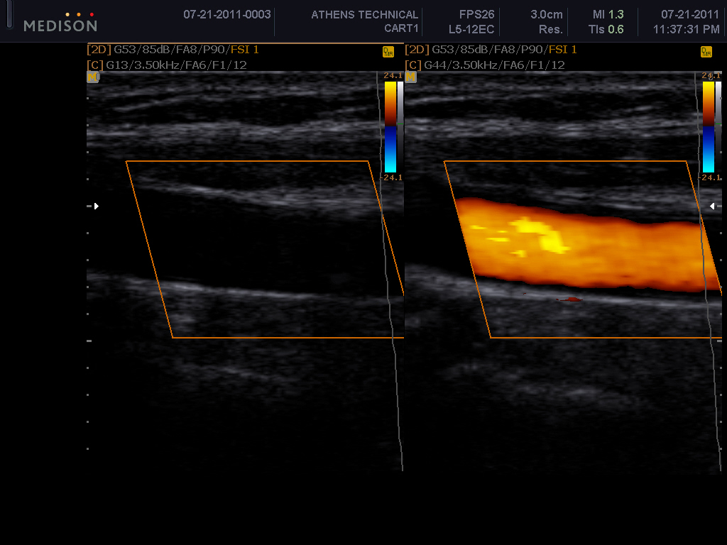
No color in image 1. What was done to get the color in image 2?
Color Gain- increased

